Slide 1
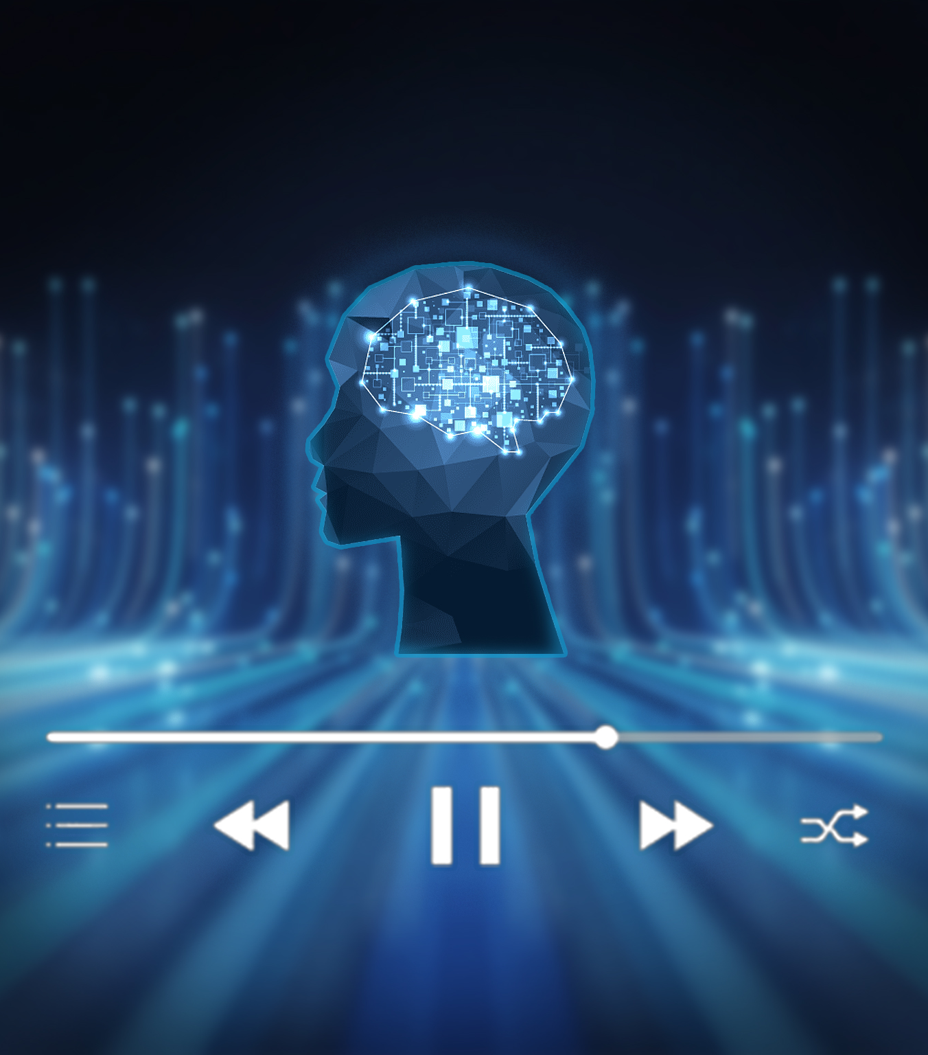
Smart Music player graduation project
phase1

Slide 2
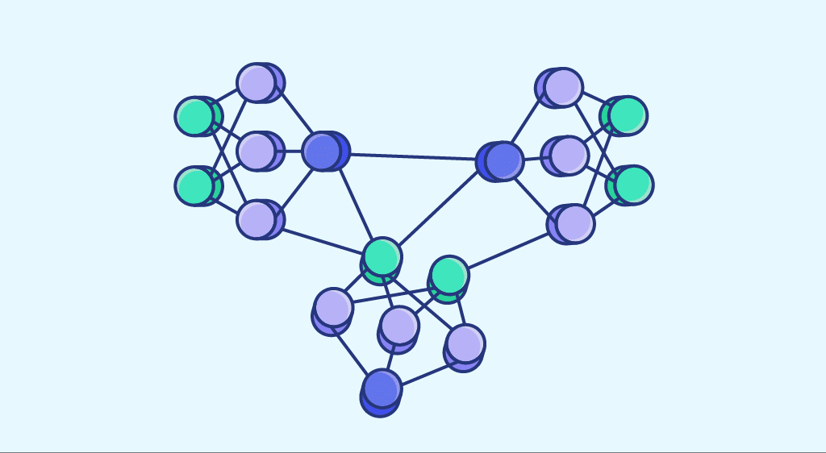
Model architecture

Slide 3
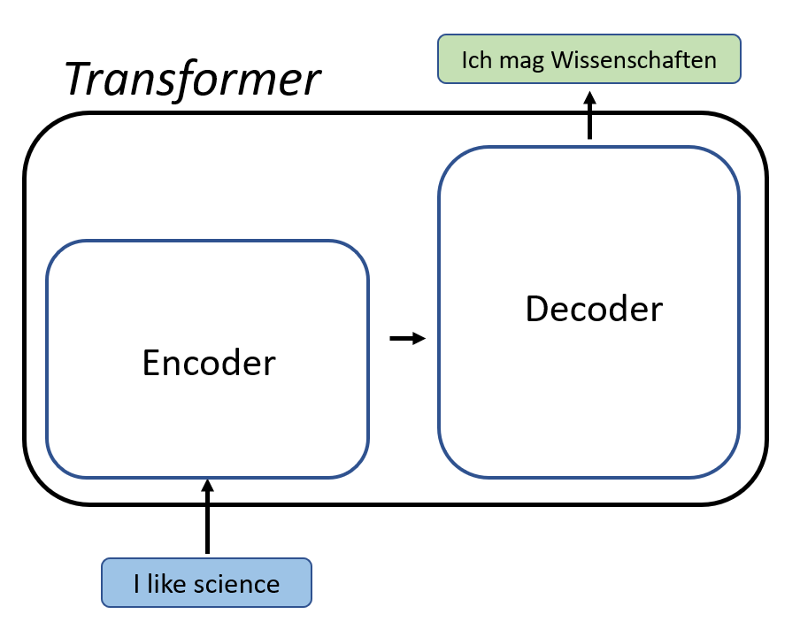
Transformers

Slide 4
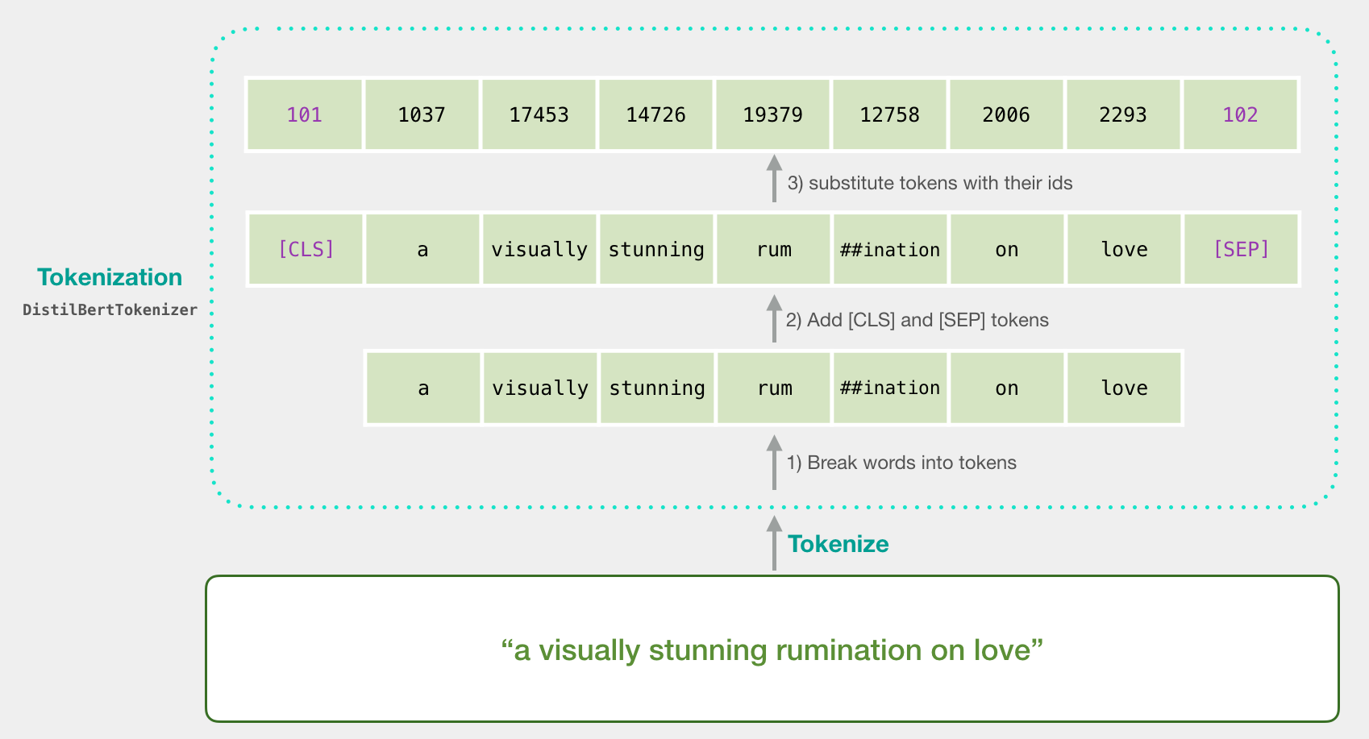
Tokenization

Slide 5
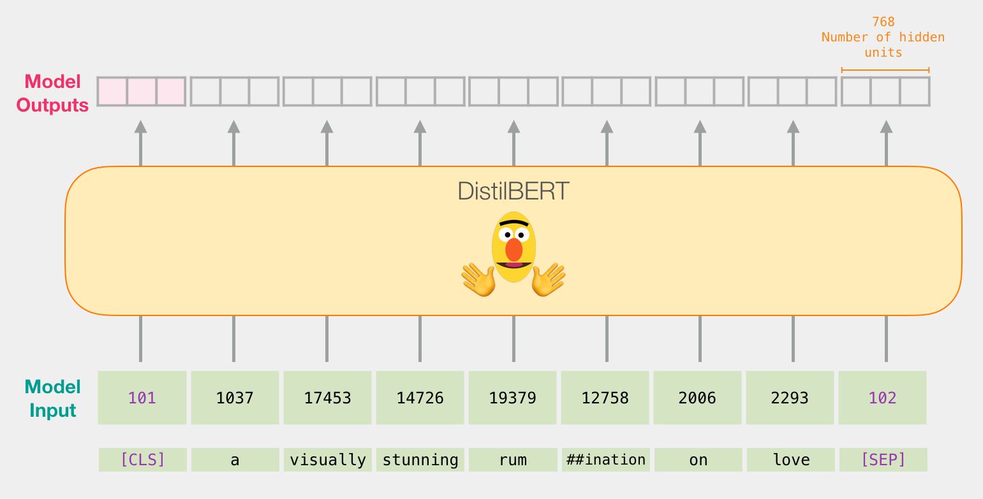
Tokenization

Slide 6
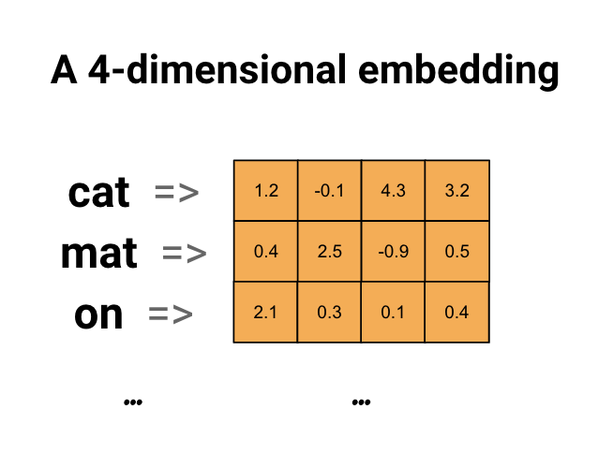
Embedding layer

Slide 7
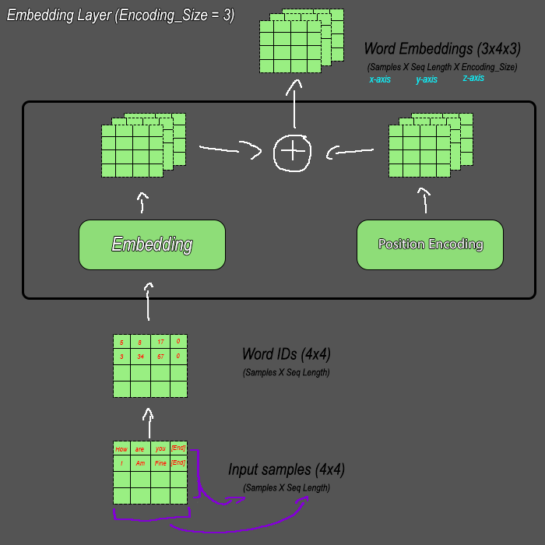
Visualizing inputs
Encoder

Slide 8
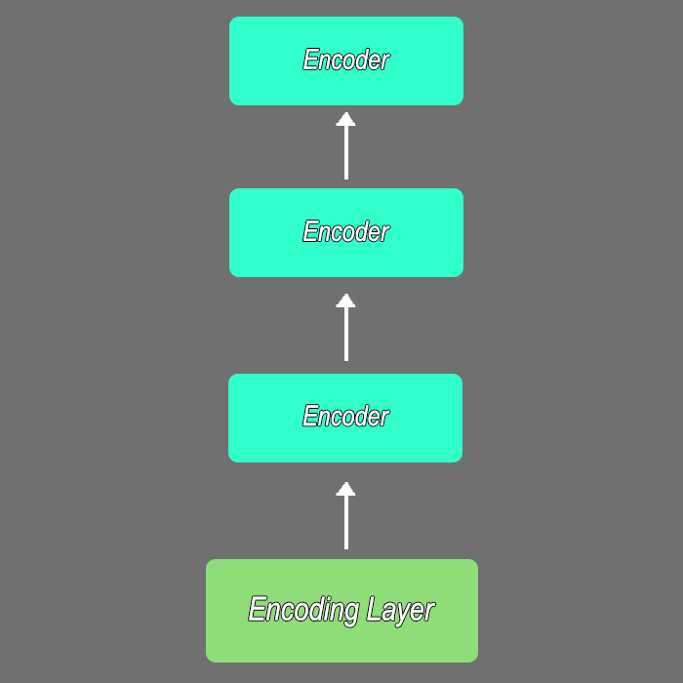

Slide 9
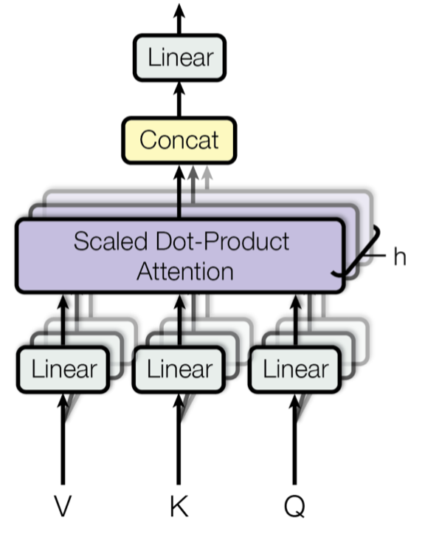
Multi-head attention

Slide 10
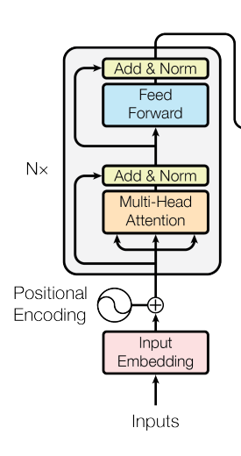
Residual (skip) Connections, Normalization Layer

Slide 11
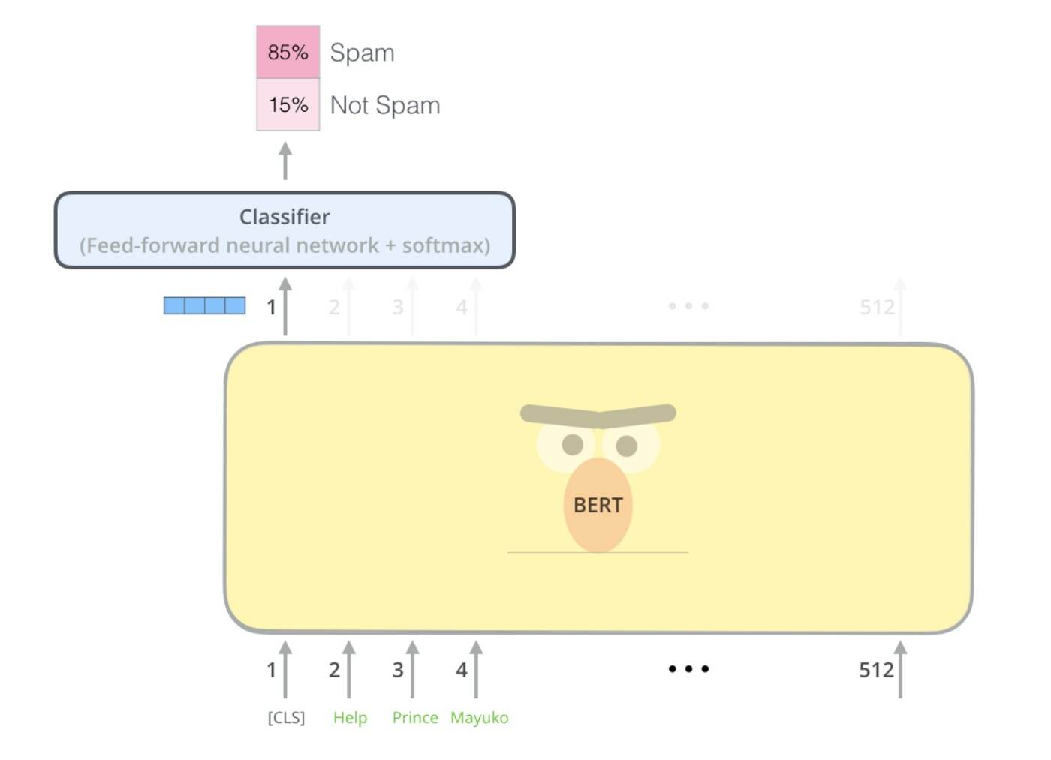
Bidirectional Encoder Representational from Transformers(BERT)

Slide 12
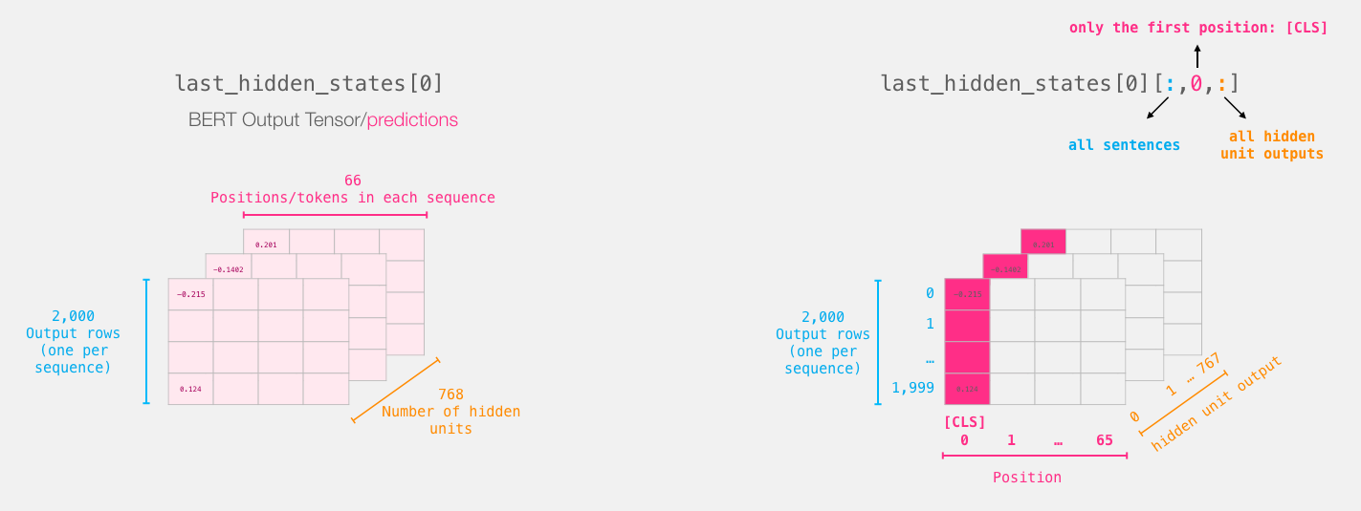
CLS

Slide 13
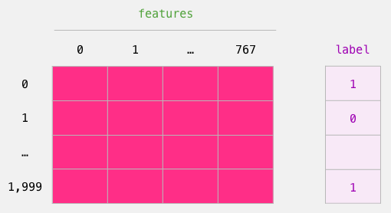
Final Output

Slide 14
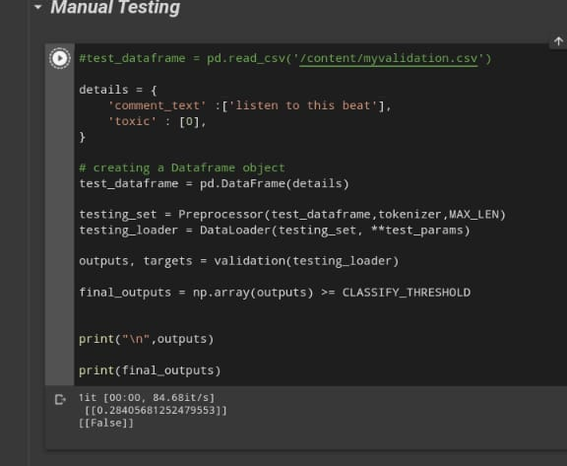
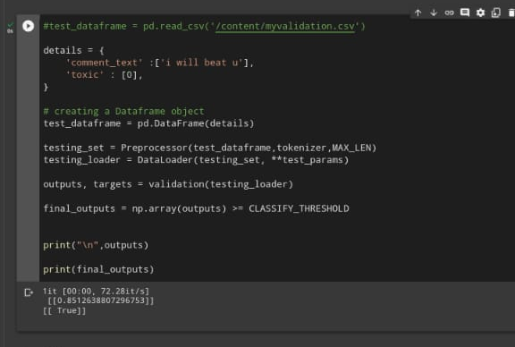

Slide 15
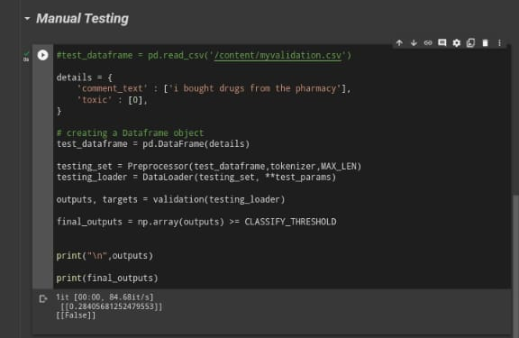
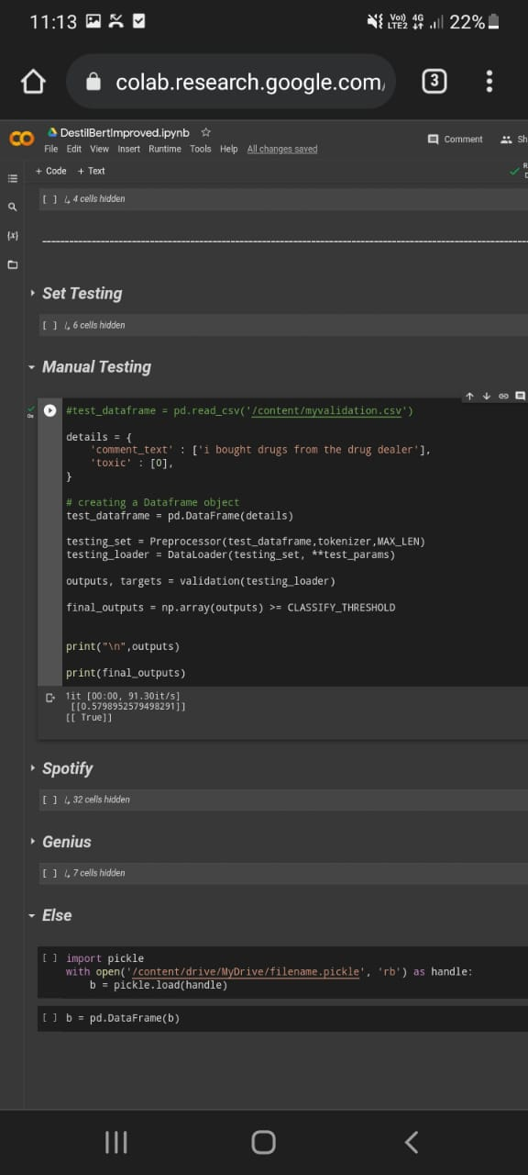

Slide 16
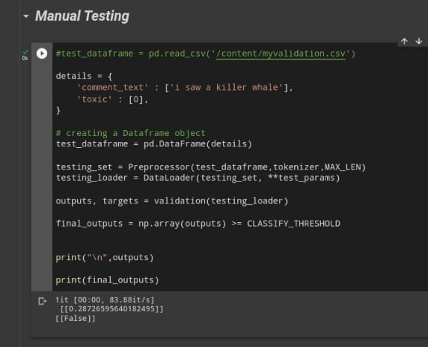
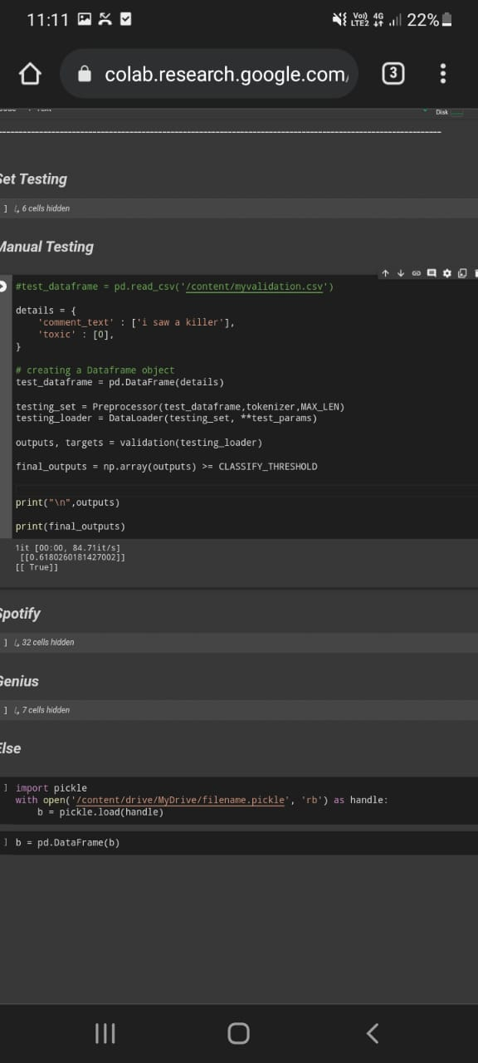

Slide 17
Genius API

Slide 18
Dataset

Slide 19
Feature of the music player(adman)
- Login
- Log out
- Insert song
- Edit song info
- Delete song

Slide 20
Feature of the music player(User)
- Login/signup
- Log out
- Control music
- view song info
- search song
- view lyrics
- Listen to the song

Slide 21
Diagrams

Slide 22
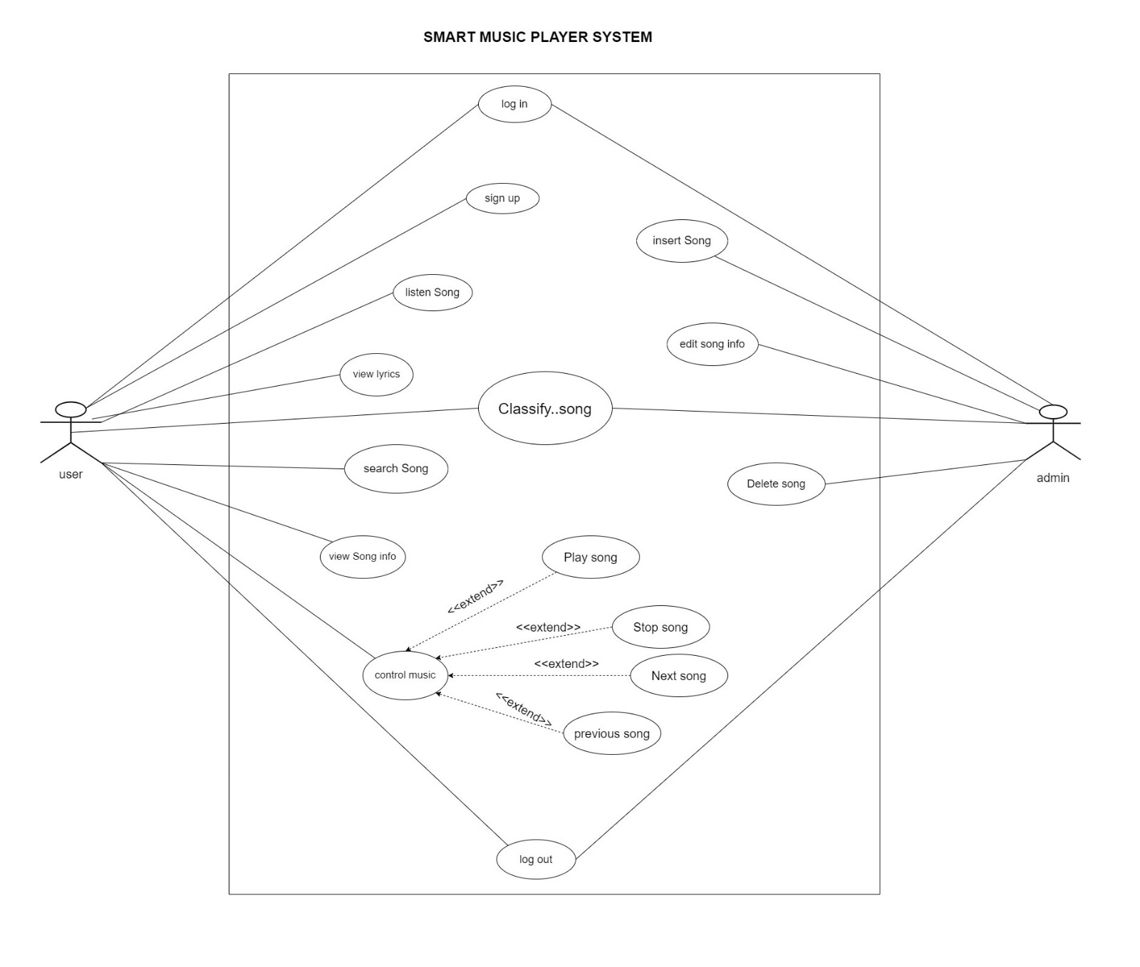
Use case

Slide 23
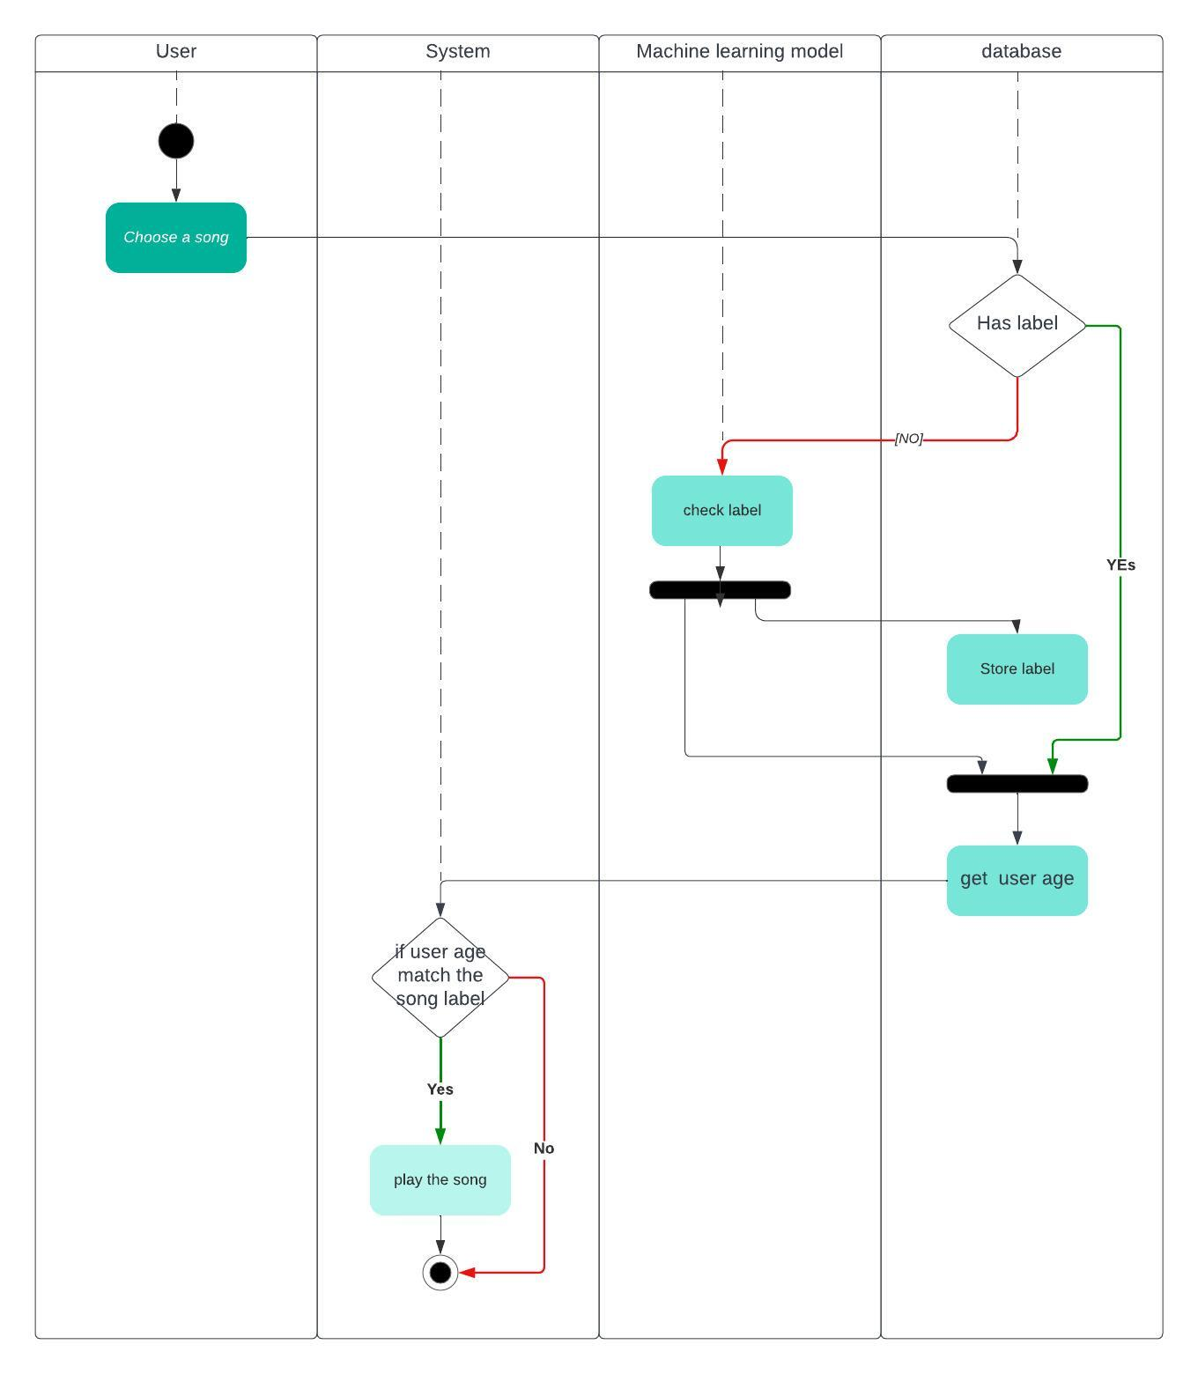
Activity Diagrams

Slide 24
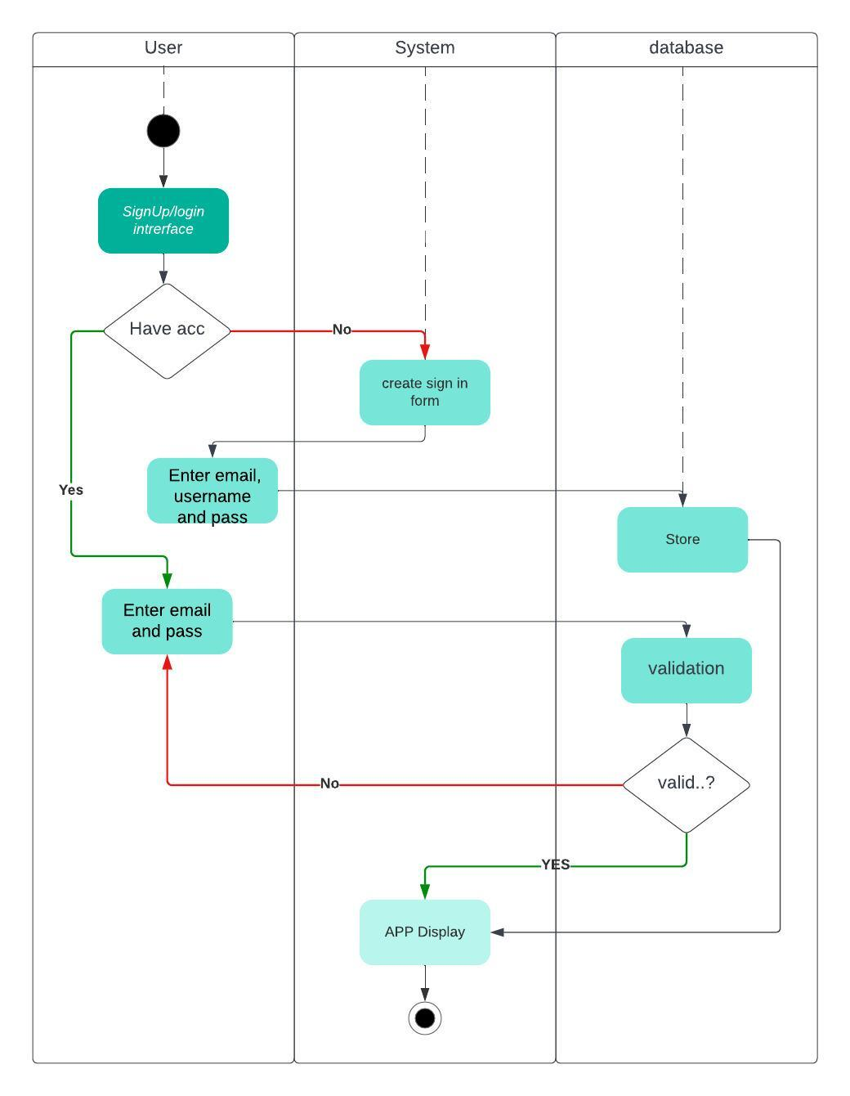

Slide 25
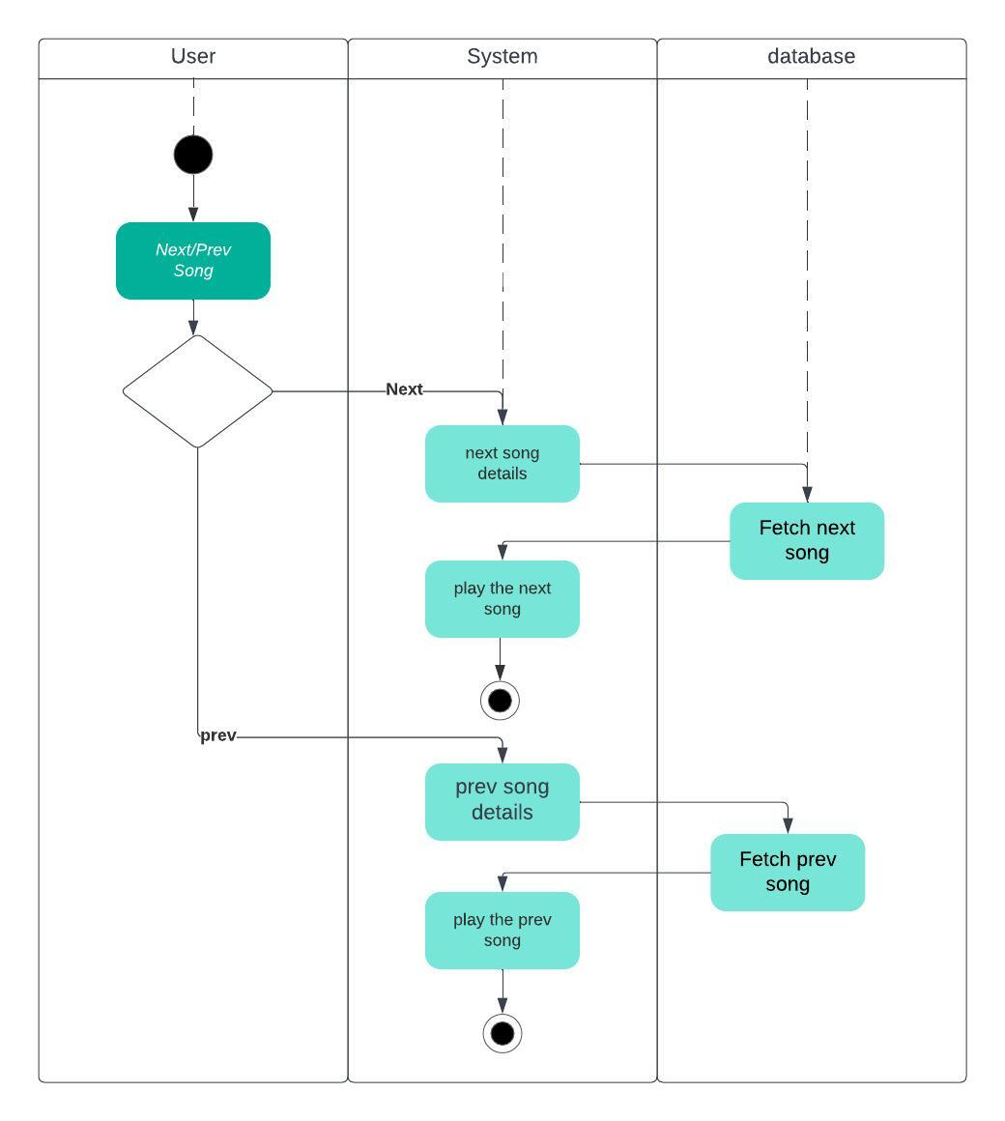

Slide 26
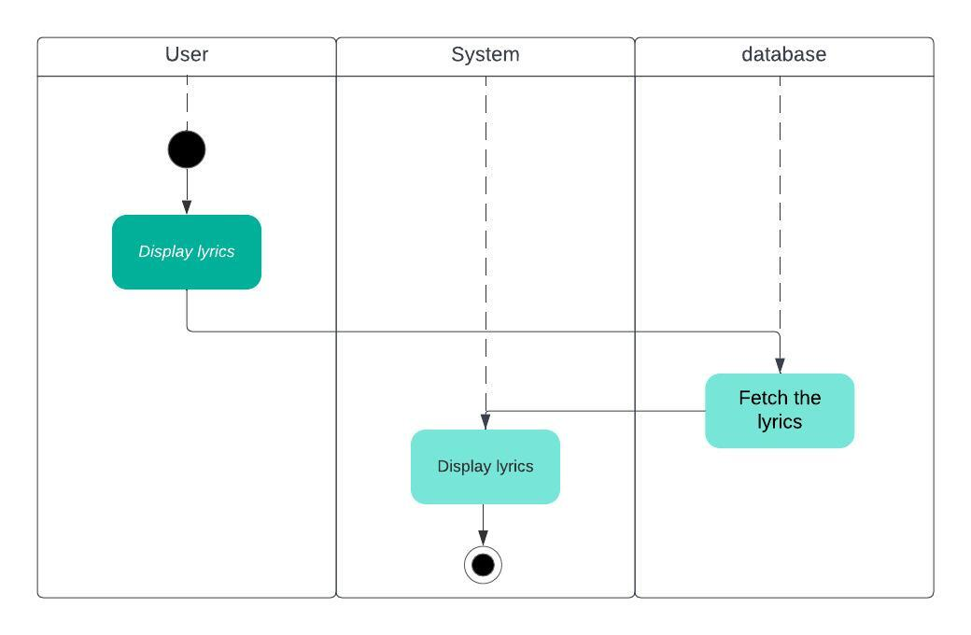

Slide 27
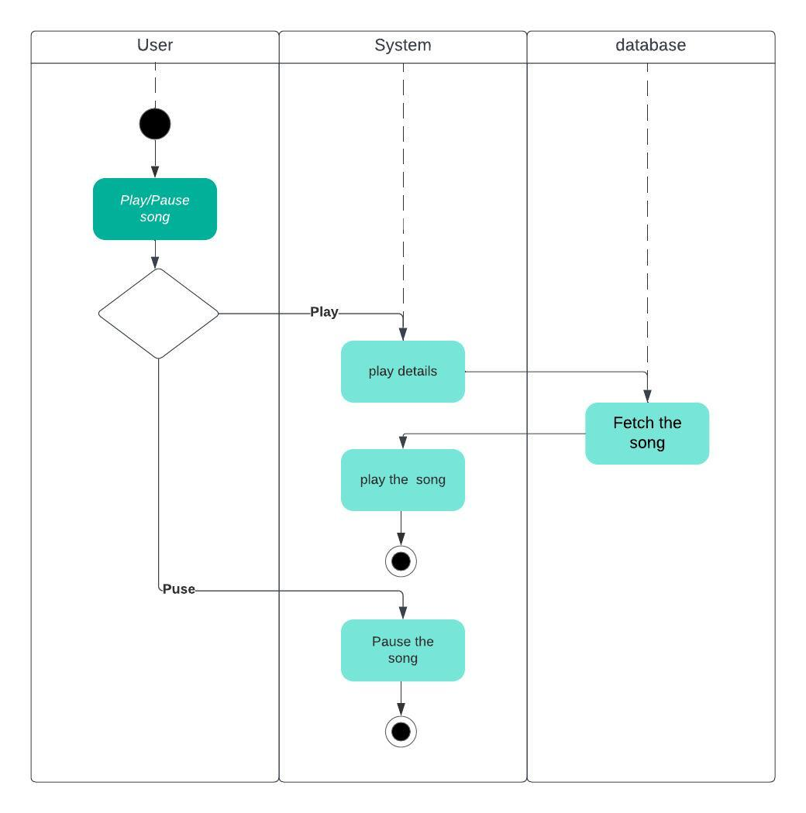

Slide 28
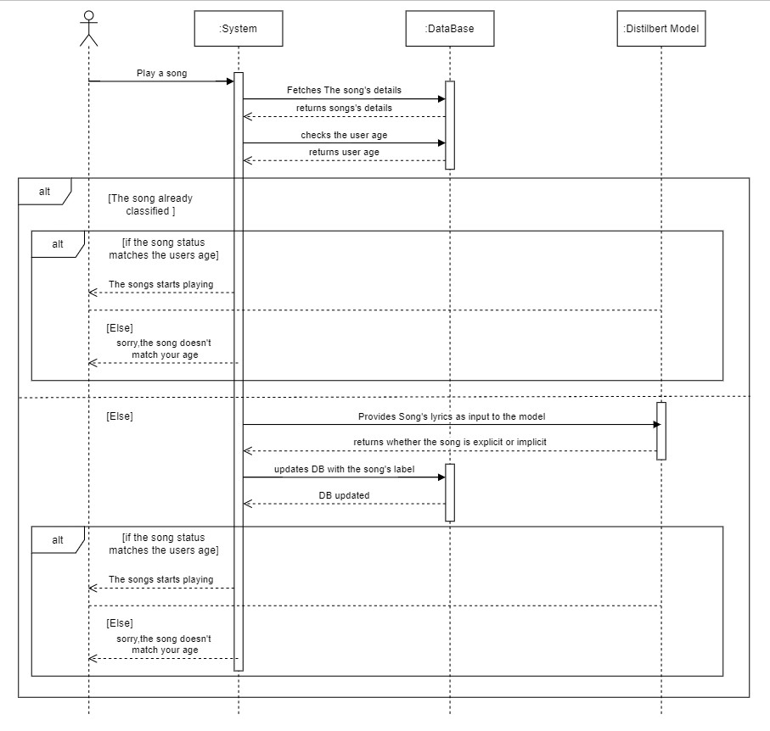
Sequence Diagrams

Slide 29
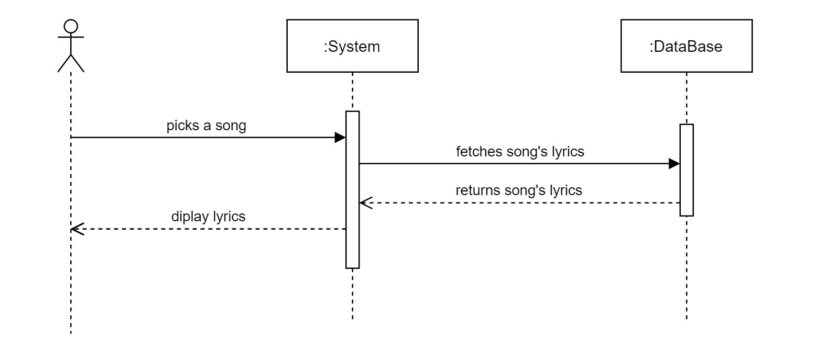

Slide 30
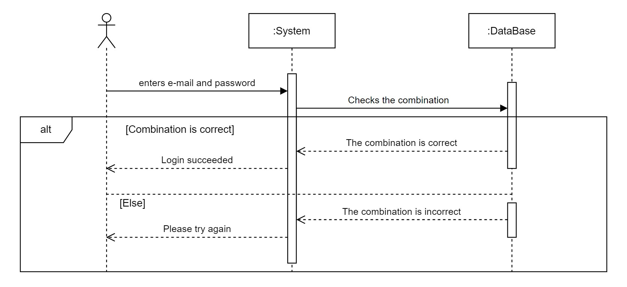

Slide 31
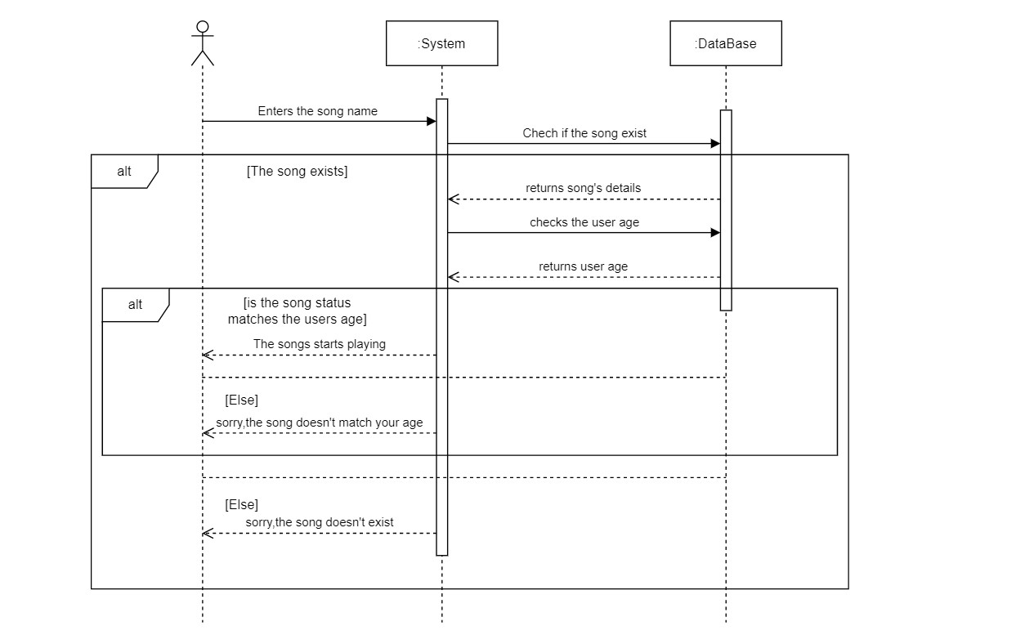

Slide 32
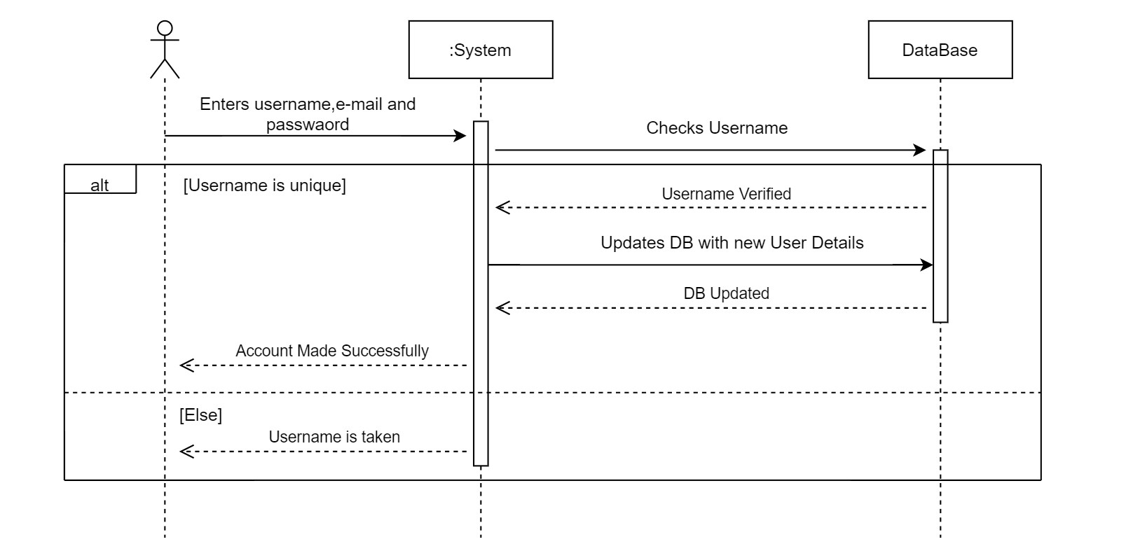

Slide 33
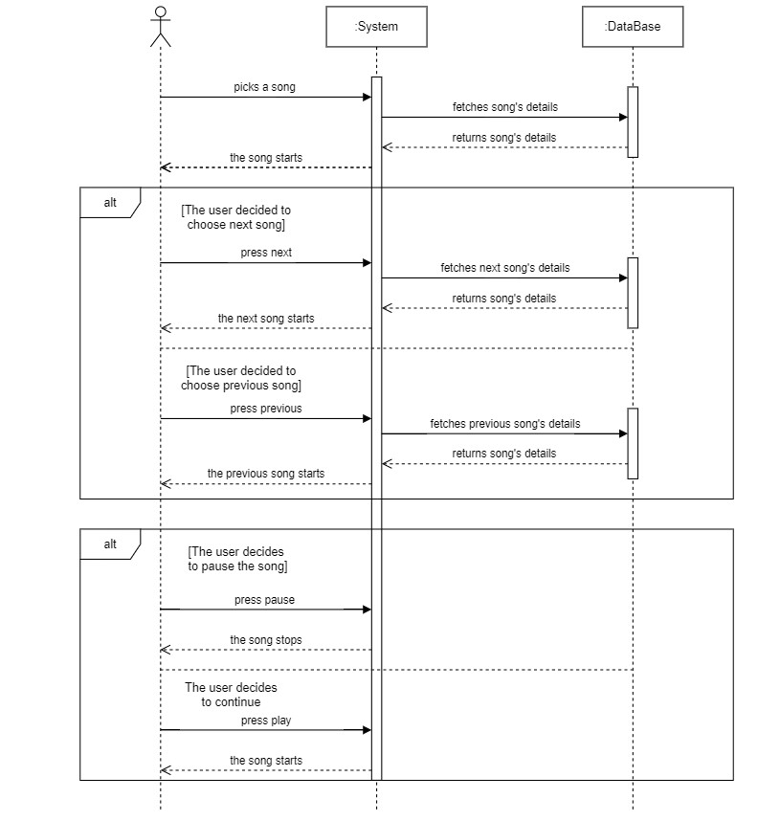

Slide 34
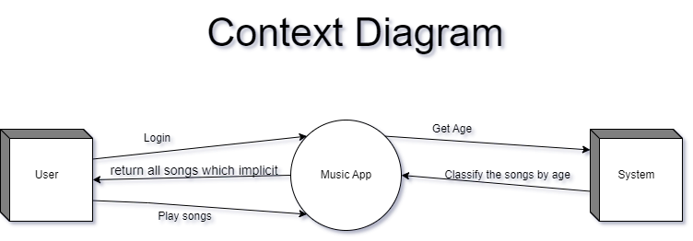
Context Diagram
Level 0

Slide 35
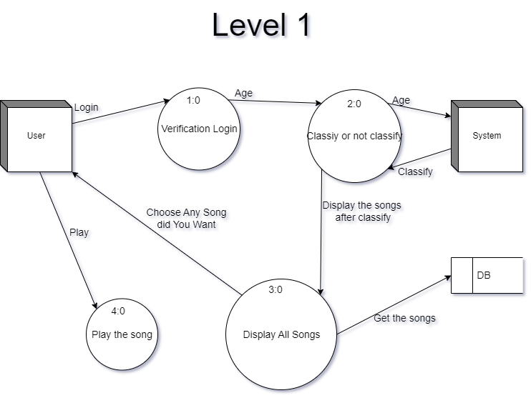

Slide 36
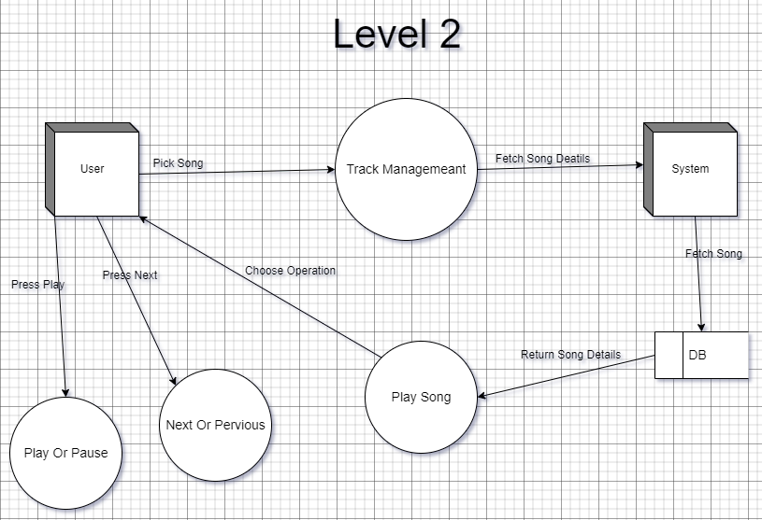

Slide 37
- محمد علاءالدين محمدرشدي احمد
- كريم محمد حسني حمادي
- محمد سعيد محمد عبدالرحمن - محمد عماد حنفي عبدالفتاح
- محمد عبدالفتاح شعبان عبدالفتاح
- يوسف سامر جورج عزمي
Thanks

